Slide 1
Ask.Me
Instructor – Professor Jia Zhang Team 8 - Charu, Gaurav, Gongpu, Leeza
[18653] Software Architecture and Design, Spring 2020
Notes:
Hello Everyone, we are team 8 and today we are presenting before you our product ‘Ask.Me’

Slide 2
Roadmap
Introduction
Motivation
Related work
System design
System implementation
Demo
Self analysis
Conclusion and recommended future work
Notes:
Let’s look at the roadmap of today’s presentation. Initially I would start with introduction, motivation and related work as well as how to run our application. We will then present our system design and implementation which will be followed by a demo. We will end by presenting self analysis and conclusion.

Slide 3

INTRODUCTION
Ask.Me is an online forum which support features such as:
Register/Login a user
Post a topic
User defined channels
Discussions over a post using
comments
Search posts/hashtags
Notes:
So, what is Ask.me? Ask me is an online forum which encourages discussions. It improves collaboration as well as helps in seeking assistance for a problem. We will tell you about all the features in detail later but the primary functionalities which we have are registration, signup, creation of a post/comment or user defined channels and we also have the functionality to search a post

Slide 4


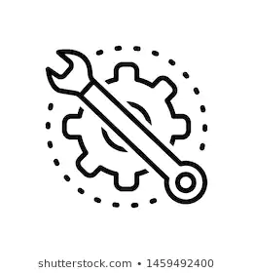

MOTIVATION
Apply various design patterns in the development of a product to make it:
Extensible
Maintainable
Available
Modular
Notes:
The primary motivation behind this project was to understand how and where to implement design patterns, And also to learn how they help in achieving the non-functional requirements in the product. We have applied patterns to make our application extensible, maintainable, available and modular

Slide 5
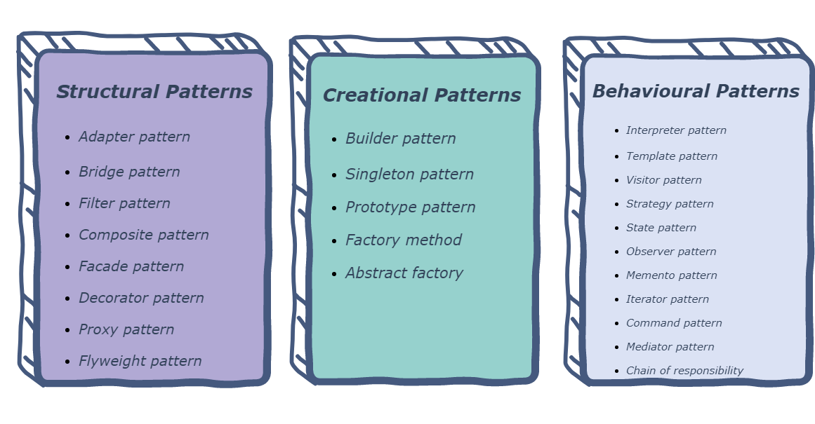



RELATED WORK
Notes:
Let’s go through the technologies which we have used. We have used Angular framework to develop front end, Playframework for backed and mySQL db to store our data. We have implemented 20 design patterns in our application.

Slide 6
How to run the application?
Backend:
Clone the repository
git clone https://github.com/jiazhang-class/18653-Team8.git
Create a database
Run CREATE DATABASE sad on mysql shell or
Use Workbench to create a database with name sad
Update MySQL credentials in conf/application.conf
Execute command run <desired_port> on sbt shell
Frontend:
In the cloned repository navigate to folder on terminal : frontend/ask-me
Execute ng serve -o on terminal
The application will startup on http://localhost:4220
Notes:
Running our application is very straightforward. We have 2 projects, each for front end and backed. To run the backend just clone the repository, create database and run application on the desired port using sbt shell. To run the frontend run ng server command on terminal. Now I’ll hand over to gongpu to explain our system’s design

Slide 7
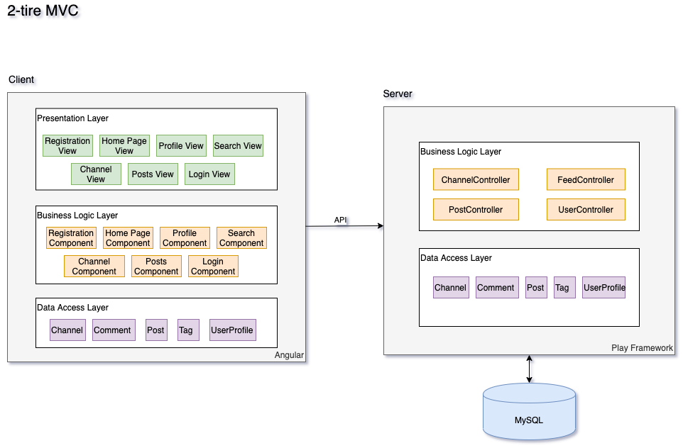
System Design
Notes:
@Gongpu

Slide 8
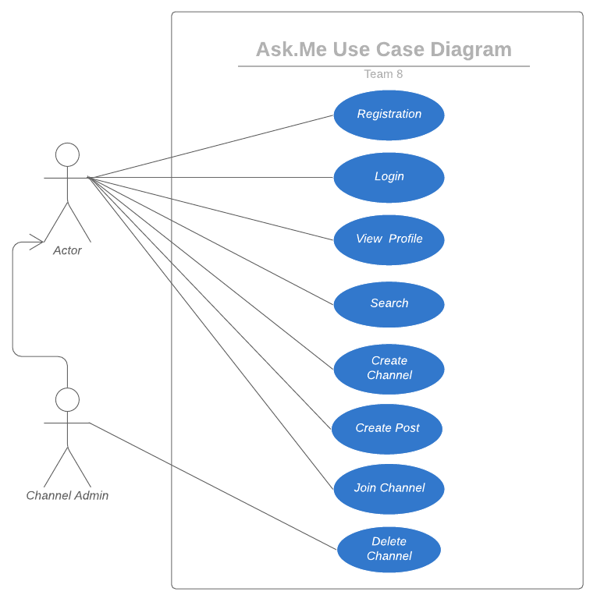
4+1 Views
Use Case View
Notes:
@Gaurav

Slide 9
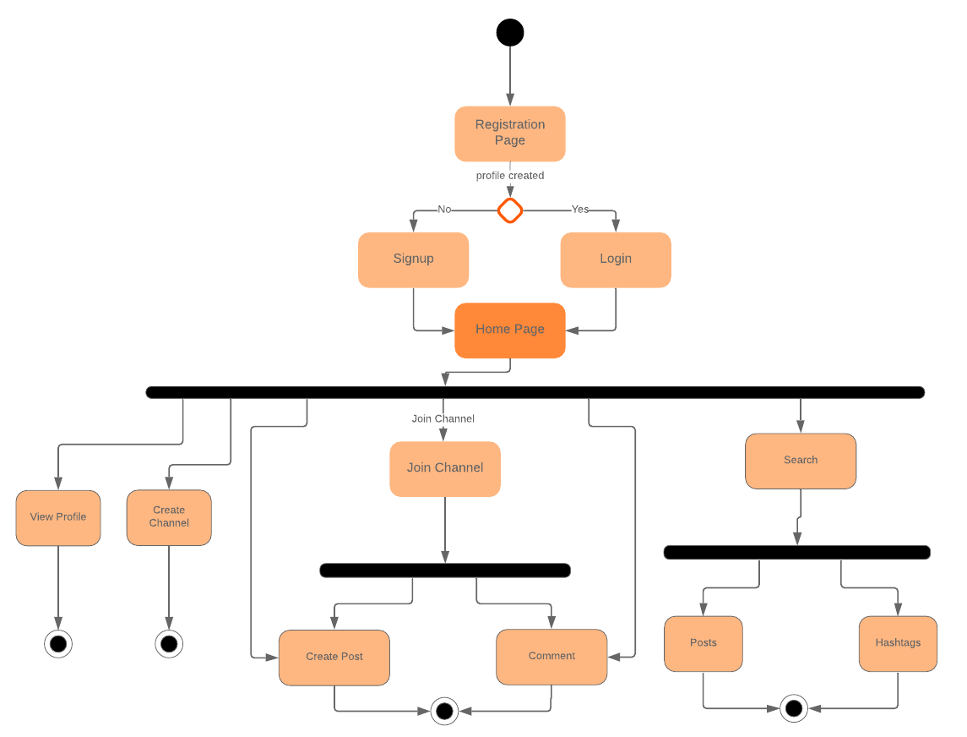
Process View
Notes:
@Gaurav

Slide 10
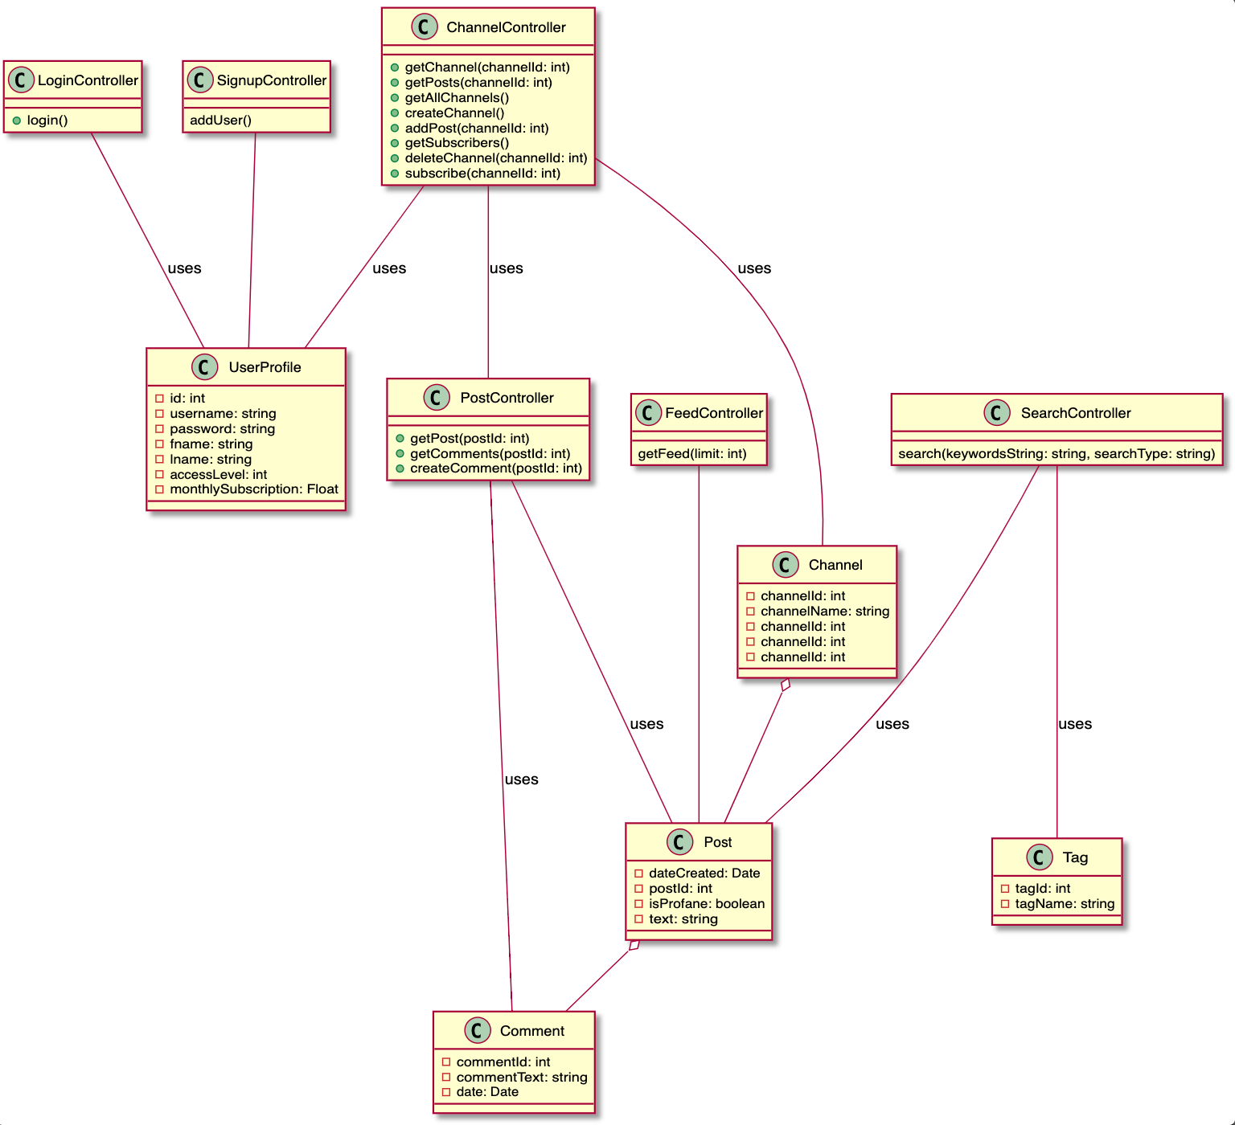
Logical View
Notes:
@Gaurav

Slide 11
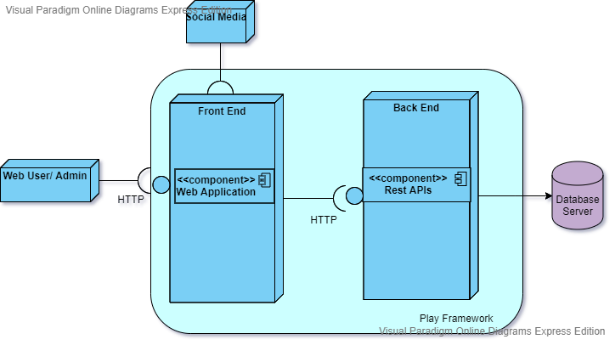
Deployment View
Notes:
@Gaurav

Slide 12
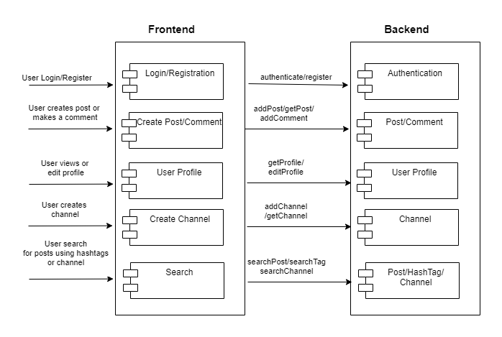
Development View
Notes:
@Gaurav

Slide 13
System Implementation
Architectural Styles
Client-Server
Client and server talk through REST APIs
2-tier MVC
Play Framework + Angular
Object Oriented
Everything is an object
Frontend: Components
Backend: Models and Controllers
Notes:
@Gongpu
We maintained an excellent API Documentation and we will show it to you later.

Slide 14
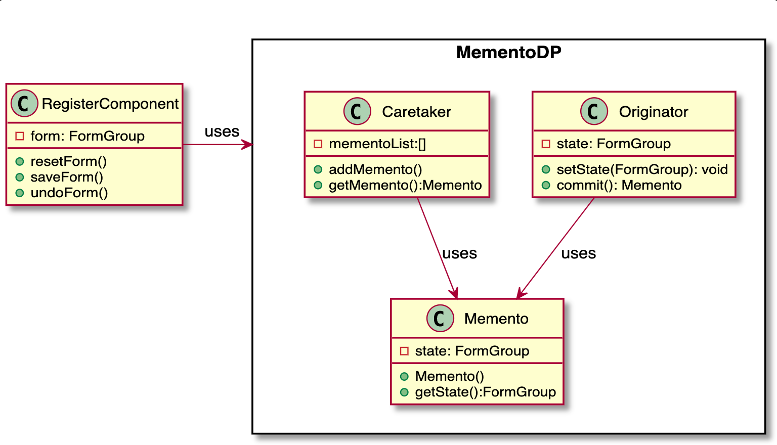
System Implementation
Design Patterns - Memento
Notes:
Problem:
One feature is that we need to give the user an option to reset the signup form or to save the signup form so that he can undo the last saved state.
Solution:
Here, we can make use of the Memento pattern. First the state of Signup Form is saved so that the user can reset the form. With it, we can also provide options for the user to save the form.
Implementation
We have created 3 classes
Memento -> stores the state of the signup form
Originator -> Creates the memento object
Caretaker -> Keeps the track of all the Mementos created
The initial state of the form with some default values is stored using Memento Design Pattern. Whenever the user clicks on the reset button the initial state is restored.

Slide 15
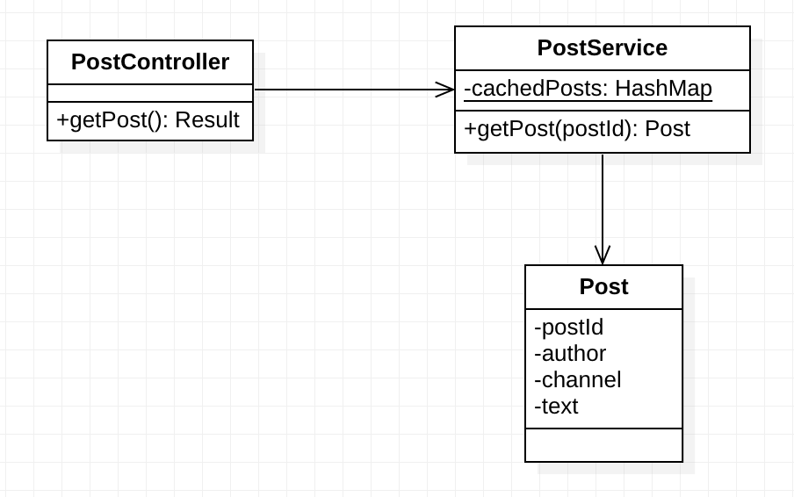
System Implementation
Design Patterns - Flyweight
Notes:
To reduce the IO footprint of database access, we use the flyweight pattern to cache posts in memory. To be specific, PostService caches posts in a HashMap keyed with their Id. When retrieving a post, we first check if it is cached in the hash map, otherwise we will fire a query in the database.

Slide 16
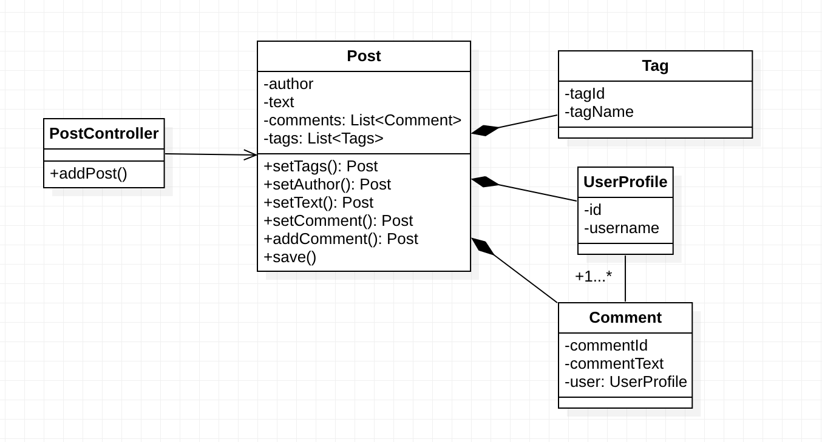
System Implementation
Design Patterns - Builder
Notes:
When creating a post on the server side, we need to set its text content, author info, tags, and comments, and save it to the database in the end. In this case, it is a perfect fit for the builder pattern. Also, we make all the setters in the Post model return the identity so that we can chain the operations until save.

Slide 17
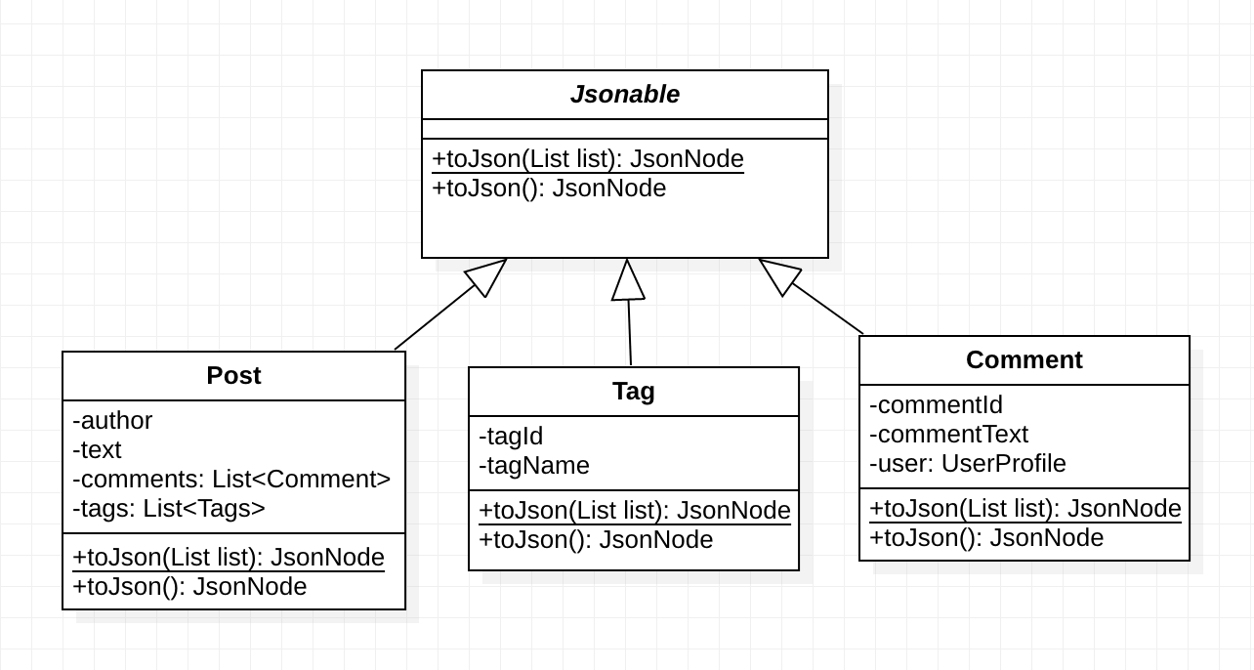
System Implementation
Design Patterns - Template
Notes:
On the backend, models should be serialized into JSON format to send as responses to the frontend. This is a common behavior across the entire backend. So we choose the Template Pattern to encapsulate such a behavior into the Jsonable interface.
The interface defines a toJson method, which converts the instance into JsonNode and should be implemented by the concrete classes, and a toJson static method, which converts a list of instances into JsonNode. Currently, Post, Tag, and Comment models all conform to this interface.

Slide 18
System Implementation
Design Patterns
5. Observer Whenever the user logs in or logs out it generates an event and notifies the navigation bar component
6. Facade Using the navigation bar, the user has straightforward access to the functionalities implemented by the system such as view profile, create post, search, login, logout, etc.
7. Mediator Multiple users can create posts on a channel and it is the responsibility of the channel to show the posts to all users
Notes:
@Leeza

Slide 19
System Implementation
Design Patterns
8. Command Each search request serves as a command containing keywords and search type (post or hashtag) from the client side
9. Filter and Pipeline We use the filter pattern to filter out unauthorized requests and only pass those valid requests to corresponding controllers
10. Singleton Each model in the backend has a static Finder instance to do queries in the database through Ebean
Notes:
@Leeza

Slide 20
System Implementation
Design Patterns
11. Factory Used for creating different types of users - admin or regular user
12. Visitor pattern Used in calculating payment amount and taxes for different types of users
13. State pattern Used to handle different states of users such as logged in or logged out
14. Strategy pattern
The Channel page allows the user to select either subscribe to channel or delete channel
Notes:
@Leeza

Slide 21
System Implementation
Design Patterns
15. Proxy Created one more handle for the payment service, payment is delegated to Paypal service through Proxy.
16. Adapter Handling incompatible interface of date string to date objects for frontend
17. Prototype To avoid the process of creation of forms from scratch by simply cloning the created registration form object whenever required
18. Decorator
To enhance the behavior of each controller at runtime by injecting the Secured class, which acts as a wrapper
Notes:
@Leeza

Slide 22
System Implementation
Design Patterns
19. Iterator Used for pagination. FeedController tries to retrieve the most recent posts, it will loop through the iterator and visit post until reaching the limit.
20. Interpreter Pattern To extract hashtags from a given string
Notes:
@Leeza

Slide 23
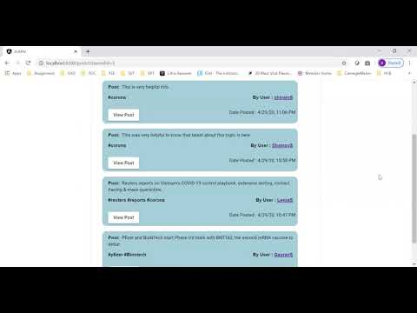
Demo
https://www.youtube.com/watch?v=VvmQ9yZr9HQ
Notes:
@Leeza

Slide 24
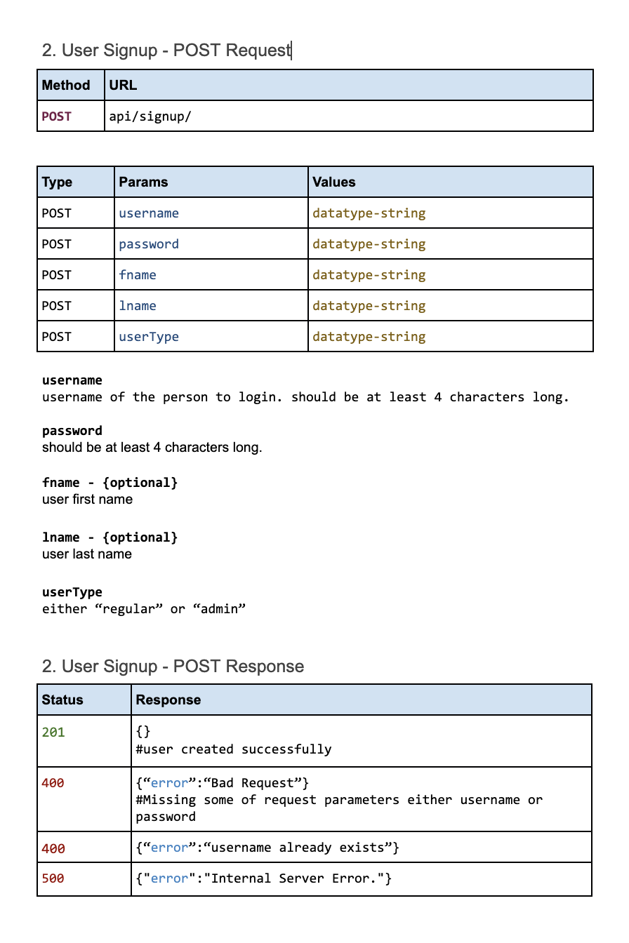
Analysis: What went well?
1. Better Collaboration - Comprehensive API documentation
Notes:
@Gaurav

Slide 25

Analysis: What went well? Continued...
2. Clean and Elegant UI
Notes:
@Gaurav

Slide 26
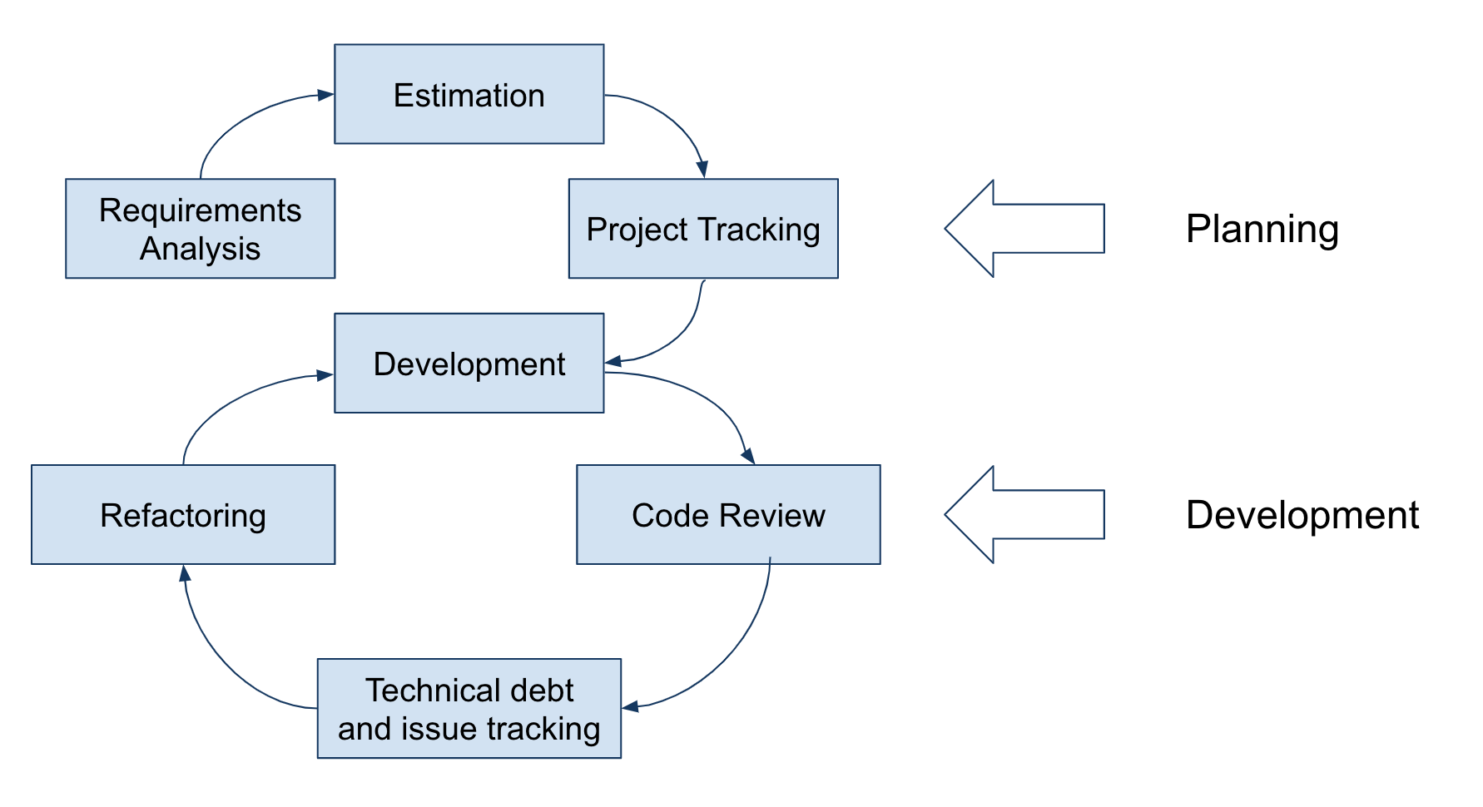
Analysis: What went well? Continued...
3. Workflow for Sprint
Notes:
@Gaurav

Slide 27
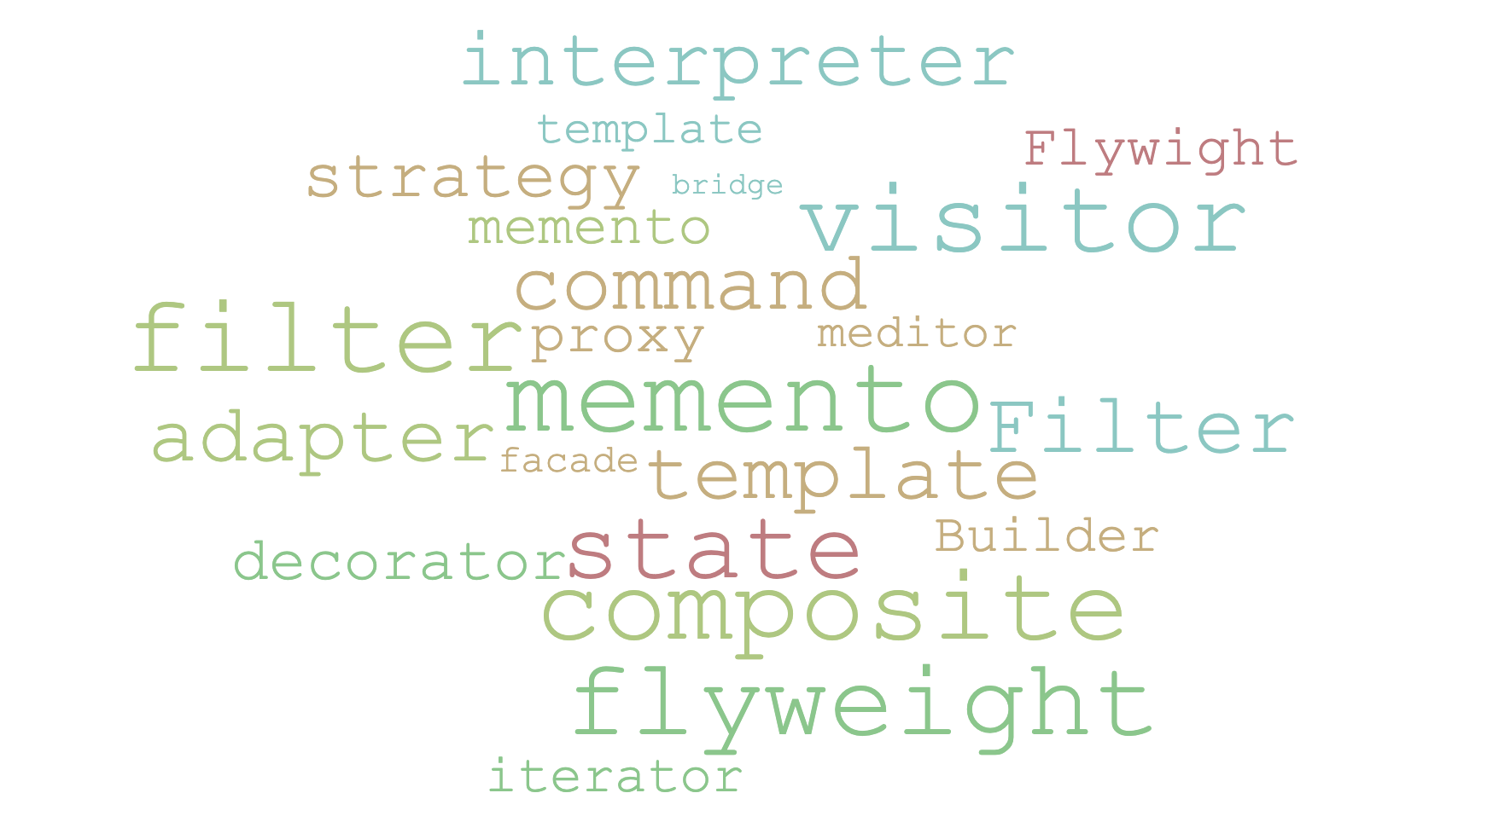
Analysis: What went well? Continued...
4. In-Depth Understanding of Design Patterns
Notes:
@Gaurav

Slide 28

Analysis: What went well? Continued...
5. Ebean ORM made our life easy
Notes:
@Gaurav

Slide 29
Conclusions
1. Understood the true potential of Design Patterns
Makes code maintainable, extensible and readable.
2. Meet functional and non-functional requirements.
maintainability, extensibility, modularity, usability
Notes:
@Gaurav

Slide 30
Future Work
1. Implement 4 more Design Patterns
Abstract Factory, Bridge, Composite, Chain of Responsibility
2. Microservice Architecture Dockerization, improves NFR (availability)
3. Test Coverage
at least 80%
Notes:
@Gaurav

Slide 31
Contact Details of Team
Team Members
Charu Thaore
Mobile: (650) 203-3661
Email: charu.thaore@west.cmu.edu
Gongpu Zhu
Mobile: (408) 368-2669
Email: gongpu.zhu@west.cmu.edu
Leeza Sinha
Mobile: (415) 609-8837
Email: leeza.sinha@west.cmu.edu
Gaurav Shegokar
Mobile: (669) 264-3189
Email: gaurav.shegokar@west.cmu.edu
Notes:
@Gaurav

Slide 32

Questions?

